Slide 1


Problem Solving Using Programming (Java) • 26SC1101E
Restaurant Billing System
A Java Console Application
team_lead.java
contributor.java
Gangavarapu Yasaswi Ram
Dondapati Nikhil Reddy
ID: 2620040139
ID: 2620040119
Team Lead: CO2, CO1 (Control Flow) & Co-Coding
CO3, CO1 (Basics), Data Collection & Co-Coding
KL University, Bachupally (ECE)

Slide 2
Why This Project?
issues.log
solution.java
Current Issues
Our Solution
✕ Manual calculation errors during peak hours.
✕ Slow service causing customer queues.
✕ Messy and illegible handwritten slips.
✓ Automatic totals using math operators.
✓ Fast, repeatable digital ordering.
✓ Clean, itemised digital receipts.
USER FLOW
STEP 01
1. Choose Category
→
STEP 02
2. Add by Code & Qty
→
STEP 03
3. Get Final Bill

Slide 3
Abstract
abstract.txt
count
count
Restaurant bills are often written and added up by hand, which is slow and easy to get wrong. Our Java console program shows a menu by category, takes orders by item code and quantity, and keeps a running subtotal. The final bill lists every ordered item and adds 5% service tax and 18% GST. It also handles a wrong code, notices when nothing was ordered, and ends with a coupon message. We built it using only CO1, CO2 and CO3 concepts.
10
4
menu items
categories
count
count
4
4
methods
arrays

Slide 4
System Comparison
Manual Methods | Our Java System
Written on paper pads. | Fast item code entry.
Calculators and human math. | Automatic subtotals and taxes.
Errors noticed late. | Instant invalid code handling.
Messy, unclear slips. | Clean, itemised digital receipts.
Takeaway: Removes hand calculation and makes billing perfectly consistent.

Slide 5
Menu Data & Storage
1D Parallel Arrays
// Sample of 10 Total Menu Items
Code | Item Name | Price (Rs)
101 | Chicken Biryani | 220.0
201 | Paneer Tikka | 120.0
301 | Egg Bhurji | 110.0
... | + 7 more items | ...
Menu stored across 4 parallel arrays: code, name, price, quantity. The same index refers to the exact same item.
Business Rules
4 Categories: Non-Veg, Veg, Eggitarian, All
Fast linear search by item code
5% Service Tax & 18% GST applied
CO1: Data Types
CO3: 1D Arrays

Slide 6
Program Flow and Topics Used
■ CO1 ■ CO2 ■ CO3
Show categories
Input type (1 to 4)
Type valid?
Yes
Show menu (switch)
Start
Not 1 to 4: prints Wrong Type Selected, carries on
Found?
Search code in array
Input quantity
No
Code = 0?
Input item code (0 = bill)
A
Yes
No
Yes
Update quantity and subtotal
Print Invalid Code
Total > 0?
Yes
Print bill: items, 5% service tax, 18% GST, coupon
No
A
A
Print: No items were ordered
End
CO1 | Basics
CO2 | Control flow
CO3 | Structure
Algorithm and flowchart first, IPO model (input: category, code, quantity; output: bill), int, double and boolean, arithmetic for price x quantity and the taxes, Scanner input and println output.
Switch-case with default and break for the menu, if-else for found or invalid and total > 0, while loops for the menu, the ordering loop that ends on 0 and the search, plus a boolean flag.
Four methods split the program into parts, four parallel 1D arrays hold the data, and we use traversal, linear search by item code and a running total.

Slide 7
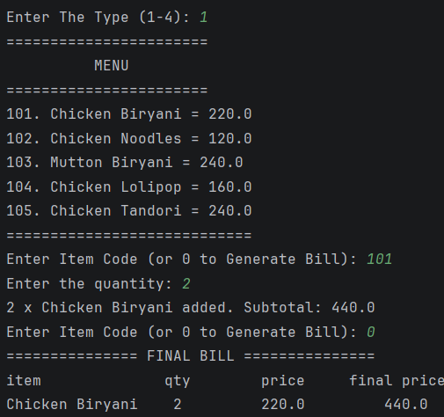
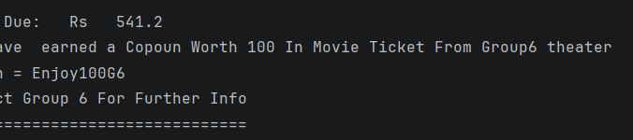
Execution Output & Receipt Demo
Console_Order_Workflow.log
Final_Bill_Summary.txt
Bill Calculation Breakdown
• Subtotal: Rs 440.0 (2 x Chicken Biryani @ 220.0)
• Service Tax (5%): Rs 22.0
• GST (18%): Rs 79.2
• Final Total Payable: Rs 541.2
Reward & Promotional Offer
• Reward: Rs 100 Movie Ticket Coupon
• Partner Theater: Group6 Theater
• Promo Code: Enjoy100G6

Slide 8

Thank You!
Presenter 01
Gangavarapu Yasaswi Ram
ID: 2620040139
Presenter 02
Dondapati Nikhil Reddy
ID: 2620040119
Upcoming Session
Next: Live output and code walkthrough
Questions & Discussion?

